Slide 1

NextHikes IT Solutions
Project 1:Scientific Calculator using Python & Tkinter
Alegapalli Kalavathi

Slide 2
Scientific Calculator using Python & Tkinter
Overview of the project
A Python-based scientific calculator using Tkinter GUI library
Math library is used to handle scientific functions like basic arithmetic, trigonometric , logarithmic and special functions.
User-friendly interface, Built-in error handling
Along with additional constants like pi , e and tau
Content of
project

Slide 3

Scientific Calculator using Python & Tkinter
Reason to use Tkinter instead of other Libraries
Tkinter provides the simple and most effective solution for creating a basic, cross-platform scientific calculation application.
Tkinter is more than sufficient for applications like a calculator, as primary focus on functional logic with a simple interface allows quick prototyping and smooth development process.
Its ease of use, lightweight nature, and built-in availability make it best option to use .

Slide 4
Scientific Calculator using Python & Tkinter
Features of the calculator
Basic operations:
Addition ,
Subtraction ,
Multiplication ,
division
01
Scientific functions:
Trigonometric(sin , cos , tan, etc.),
logarithmic(log, log10 , log2), and
other advanced operations(gamma, mod).
02
Basic
operations
Menu options:
Switch between Standard and scientific modes
Scientific
functions
06
Menu
options
Constants:
Pi , e , tau.
Error
Handling
constants
03
UI
components
Error Handling:
Division by Zero,
gracefully handled Invalid inputs
05
UI components:
Input box for display,
Buttons for numbers
functions
04

Slide 5
Scientific Calculator using Python & Tkinter
Python Code - Overview
Structure of the Code:
Imports: Tkinter for GUI.
math for scientific operations.
Class-based Structure: The Calc class contains methods for operations.
Functions: Each button on the calculator has a corresponding function (e.g., numberenter, operation, sum_of_total).

Slide 6
Scientific Calculator using Python & Tkinter
Python Code - Overview
Main Functionalities
Button Press Handling:
numberenter(num): Updates the current input when a number is pressed.
sum_of_total(): Finalizes the result after an operation.
S
Scientific Functions: sin(), cos(), log(), etc., for mathematical operations.
Clearing Functions:
Clear_Entry(): Clears the current input.
All_Clear_Entry(): Resets the entire calculator.

Slide 7
Scientific Calculator using Python & Tkinter
User Interface Design
GUI and Layout
The layout is grid-based with rows and columns for buttons.
Input box (txtDisplay): Displays the current input or result
Buttons: Organized for basic operations and scientific functions.
Menu: Allows switching between Standard and Scientific modes.

Slide 8

Error Handling and Edge cases
Handling invalid operations: E.g., dividing by zero, negative inputs for square roots.
Try-except blocks: Used to display error messages instead of the program crashing.
Message Boxes: Using tkinter.messagebox to display errors such as division by zero.

Slide 9
Scientific Calculator using Python & Tkinter
Conclusion
The Scientific Calculator code is built using python and Tkinter, providing powerful graphical user interface for performing both scientific and arithmetic calculation.
Basic input validation ensure no division by zero and duplicate decimal points are prevented
Overall, the code successfully implements a fully functional scientific calculator with intuitive interface, demonstrating the power of python for creating desktop applications

Slide 10
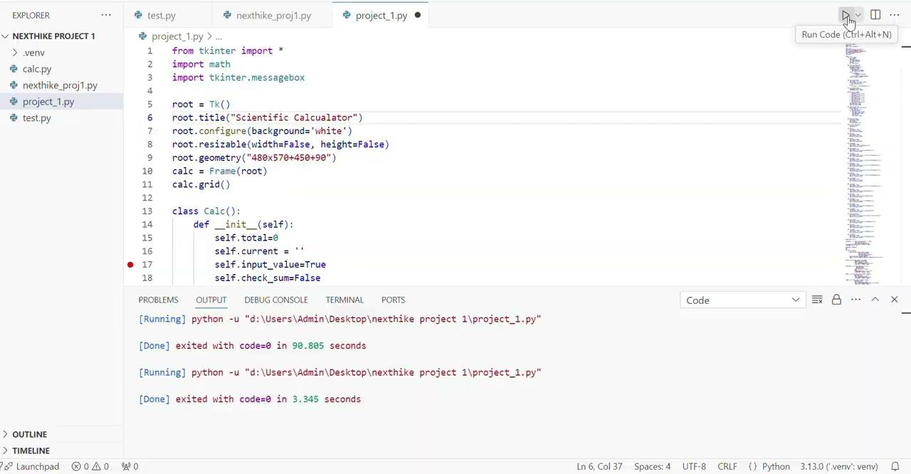

Slide 11
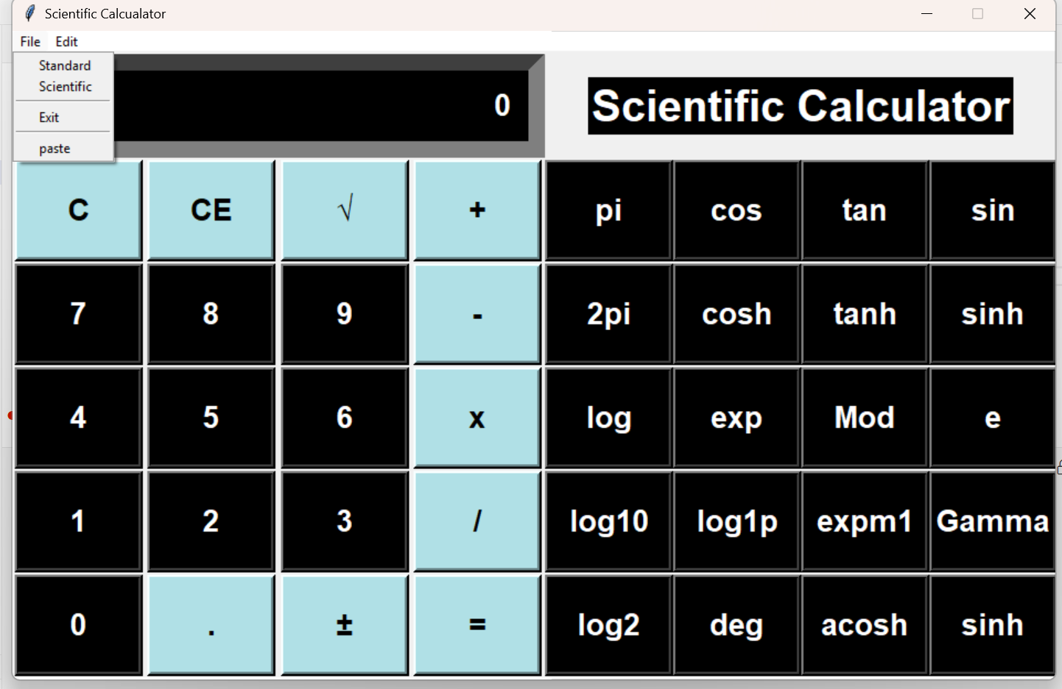
overview of calculator

Slide 12
THANK YOU

